Slide 1
Altering display with pipes and styles
Spencer Schneidenbach

Slide 2
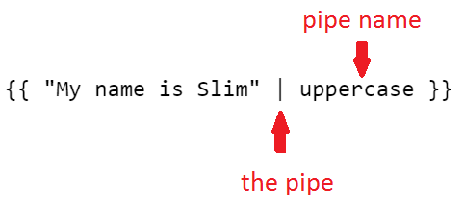
Pipes
Filters in Angular 1
Alters the display of an interpolated expression

Slide 3
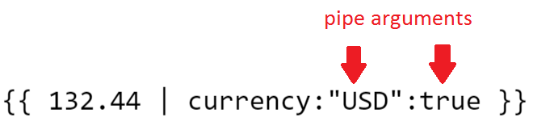
Pipes, cont’d
Pipes can take arguments/parameters
Parameters are expressions like everything else
Separated by colons :

Slide 4
Some built-in pipes

Slide 5
Pipes no longer
A few filters didn’t make it over from Angular 1
orderBy and filter
Why?
Performance
Separation of concerns

Slide 6
Styling
Lots of different things to choose from!

Slide 7
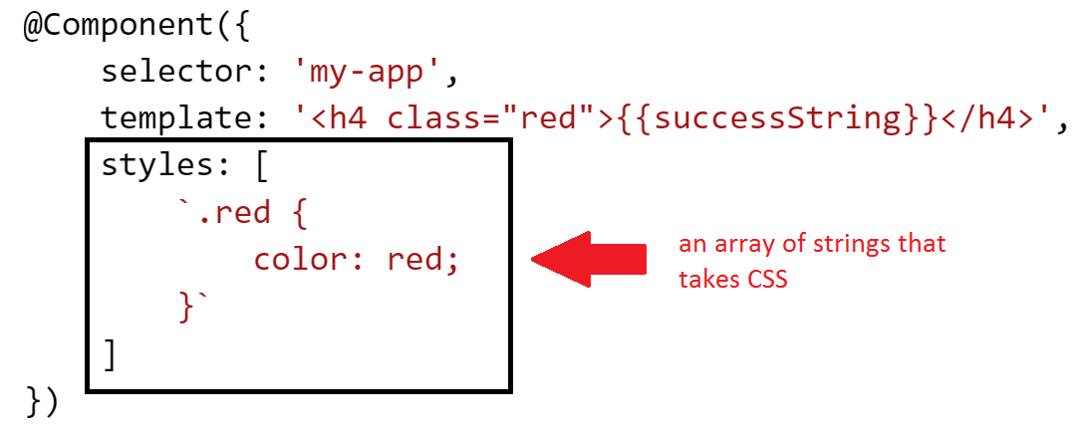
Styles directly on component
You can add CSS directly to a component!

